Slide 1
Data Science: Project

Slide 2
Basic Structure of the Project
Title
Abstract
Introduction
The problem (context)
Purpose of the study
Project description
Hypothesis
Methods
Analysis
Results
Implementation (optional)
Conclusion

Slide 3
Project
< Ground coffee sales/customer analysis in 2021 in Indian Market >

Slide 4
Outline of the Project
<Problem-
1. Market analysis
2. Consumer Behavior
3. Customer analysis
Solution-
Hypothesis
Accessing and cleaning data
Data and statistical analyzing
Excel/python for visualisation>

Slide 5
Justification of the Project
<The project is chosen related to understanding the market and business-driven analysis that covers sales(demand and supply), customers’ perspective.
It helps me use the data to clean and other tools to reach my goal.>

Slide 6
Datasets
<The data set will be taken from online resources and credits will be shared of each resource.>

Slide 7
Desired Outcomes
The desired outcome is to -
Profit to business
Future Goals for a business
Customer-oriented strategy

Slide 8
Abstract
India is most known as a tea-drinking nation but over years café tradition has added a wave of coffee drinkers ranging from cappuccino to latte but mostly homemade coffees were still instant coffee. The coffee had an unadulterated version known as Chicory, it blended well with Indian palate.
Ground coffee using different equipment like Aeropress, French Press, V60 is considered to be Gourmet coffee. With the rise of social media trends and Covid lockdown boosted Ground coffee business, an experience at your doorstep.
Tough Indian coffee is globally exported from years and grown in Southern Part of Indian. It has been part of their culture as well. Coffee roasting has taken a boom in the market, hence the sales of ground coffee has made its mark in India.

Slide 9
Introduction
This ground coffee was a wave also known as Third Coffee Wave.
Companies like Starbucks and Blue Tokai sourced their beans from selective Southern India regions and roasted in house. They spread the word across metropolitan cities with the younger professional audience that was addicted to coffee accompanying them through the day with work.
Now you can find multiple roasters, well-trained and certified like Subko coffee, Bombay Island coffee company, sleepy owl, and Third-wave coffee roasters giving competition to Blue Tokai.
This wave has given consumers an understanding of their taste and experience of how to select beans and brew them through different techniques and equipment.
This leads us to the sale of ground coffee has made, which will be divided into Arabica and Robusta.

Slide 10
Context
The market is divided into two types of ground coffee, the sales get affected as per the knowledge of beans, one’s personal taste, and cost.
These beans are roasted in Light, dark, medium and medium dark roast.
Arabica - beans tend to have a sweeter, softer taste, with tones of sugar, fruit, and berries. Their acidity is higher, with that winey taste. It is pricier.
Robusta- has a stronger, harsher taste, with a grain-like overtone and peanutty aftertaste. They contain twice as much caffeine as arabica beans, and they are generally considered to be of inferior quality compared to arabica.

Slide 11
Context
Data was gathered and cleaned in Excel-
Sales of the ground coffee-

Slide 12
Purpose of the Study
To understand to study data for a business
Understanding the market and its trend
Purpose of the study of the topic is to understand the growing sales in the past year on a certain section of a product- Ground coffee.

Slide 13
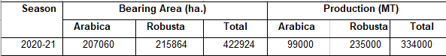
Project Description
Ground coffee is widely grown in different regions before going for production or exported to other countries.
Here is the background on the ground coffee production in 2021, that is the base before moving to the sales of the product.

Slide 14
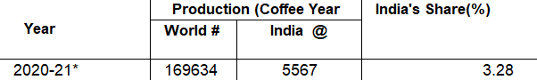
Project Description: Hypothesis
Social media has impacted sales to a higher extent.
There has been more awareness and knowledge explored during the pandemic of gourmet coffee at home.
The highest sale and production of ground coffee in India increased in 2021 and keep on moving forward at present.
The sales of equipment got impacted by the rise in demand for ground coffee in different forms- roasted beans and powder.
Indian market is increasing it shares in International market and exporting.

Slide 15
Project Description: Methods
Principle-
The data gathered from open sources needs to be authentic sources.
2. Process-
The data was cleaned to analyze
3. Tools-
The tools used were excel to study the data
4. Execution-
Visualisation of the data
5. Hypothesis and conclusion-
Data supported analyses were made
Understanding of product market and consumer

Slide 16
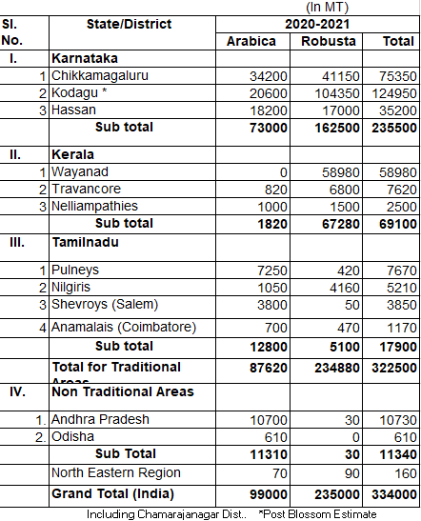
Project Description: Analysis
The product sales were analysed through its base which is the state-wise production across India. Most of the regions in Southern India are known for their climate and soil for growing coffee. Various such elements affect and impact in the sale of the ground coffee and where they are coming from.

Slide 17
Analysis
Southern regions-
Tamil Nadu
Karnataka
Kerela
Are considered the highest producers of ground coffee.
Whereas the Eastern region is known for its tea production but produces some amount of coffee. Hence those are non-traditional areas of coffee growth.
Robusta has the quality to grow in lower regions as well. So the production in the eastern region is higher of it than in Arabica.

Slide 18
Analysis

Slide 19
Project Description: Results
The results show the relationship between the awareness and marketing affecting the production and sales of Ground coffee within the country.
Tea drinking country is choosing different methods of coffee and adapting to a different lifestyle.
The traditional areas known for coffee growth are more favorable than non-traditional as per their climate and farming techniques.
Companies’ approach to the metropolitan city has made a difference in the sales hike.

Slide 20
Conclusion
The latest survey and data for 2021 depict the profit for brands, non-branded companies, and upcoming businesses that can accelerate in this scope of the area.
A non-conventional area of interest and business can be explored further, ground coffee is reaching to at par with what instant coffee has been in the Indian market.
The data can help the companies to develop a strategy for the demand and supply and ways to market and reach their targeted audience.

Slide 21
Bibliography
https://www.indiacoffee.org/
Market Research and Intelligent Unit Coffee Board
https://www.newindianexpress.com/thesundaystandard/2019/sep/08/the-indian-consumer-is-embracing-a-new-wave-of-coffee--2030441.html
https://thisismold.com/process/manufacture/coffee-in-the-cup-roasting-and-brewing-in-indian-coffee-culture
https://www.deccanherald.com/business/coffee-gaining-ground-in-india-among-genz-report-780362.html

